Slide 1


Novel Combustion Concepts for Emerging Propulsion Systems: Heated Air Cycle Engines - Extending Mission Range/Endurance Propulsion and Power for days, months, years September 2018
Advanced Concepts Group
Turbine Engine Division
Aerospace Systems Directorate
For Official Use Only

Slide 2
BLUF
Other countries (Russia and every Nuclear power besides the US, including China, Iran, Pakistan, India, UK, France, and Canada) can develop propulsion and power systems that operate far beyond the capabilities of conventional Hydro-Carbon fuels (ie, 1,000 to 100,000 times the energy density of jet fuels). Von Karman’s 1946 report to Gen Hap Arnold described exactly how to do so and Russia has been using those systems (see 4 month loitering cruise missile).
We (AFRL, DoE, NASA) believe we can develop such a capability and make it potentially safer than conventional fuels. The Heated Air Cycle Engine approach essentially stores energy in a very high density and useful form, enabling ground power, aircraft that don’t require refueling for months, high power/small APU’s, and long range hypersonic vehicles. Imagine the resource savings if we could eliminate 99% of UAS takeoffs/landings, remote airfields and bases, and the need to logistically support jet fuel to field global air power capability.
Imagine the shift in global power if some other country follows von Karman’s 1946 recommendations for the future of Air Power…
If you believe the world won’t be flying on oil in the next century, then who is going to develop that capability?

Slide 3
Turbine Cycle Energy Input
Conventional Turbine
Throttleable
Consumes Fuel
Combustor
Inherently Simple (only rotating parts)
Waste Heat Leaves as thrust
HACE acts like a self-sustaining recuperated cycle
Consumes Heat
Waste Heat?
Hybrid Fuel-Cell?
Beamed Power?
Fission?
Fusion?
Positrons?
Isotope Decay
LENR???…
Heated Air Cycle
Engine (HACE)
Heat Exchanger
(sized for cruise power)
Combustor
(only used for takeoff/climb/dash)
10

Slide 4
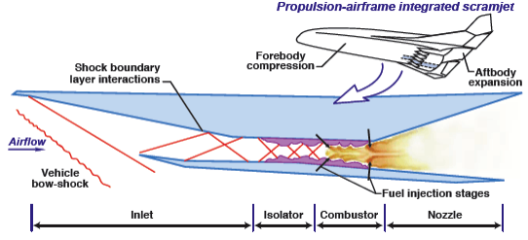
Ram/Scram Cycle Energy Input
Conventional
Throttleable
Consumes Fuel
Consumes Heat
Waste Heat?
Hybrid Fuel-Cell?
Beamed Power?
Fission?
Fusion?
Positrons?
Isotope Decay
LENR???…
Heated Air Cycle
Engine (HACE)
Heat Exchanger
(sized for cruise power)
Combustor
(only used for accel/climb/dash)
10

Slide 5
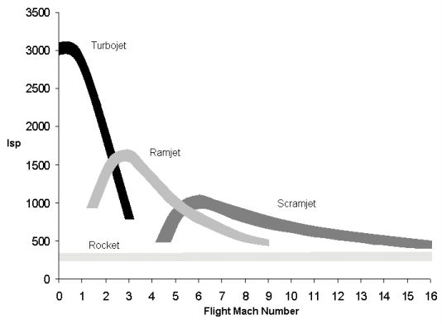
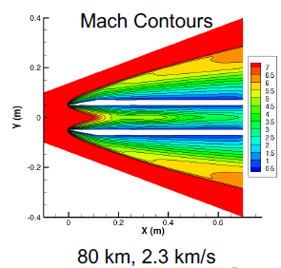
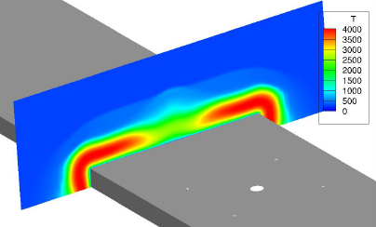
Three ways for high speed HACE (enabling RAM/SCRAM)
Ram (don’t we care about Isp when ‘fuel’ energy density is 1,000 to 100,000 times conventional)
Supersonic Heat Exchanger
Heated Particle Injection (enables thermal management) or pitch/catch secondary HEX loop (TRL commensurate with illustration)
RTO-EN-AVT-116

Slide 6
Energy Storage
Energy Source Energy density
HC (+ 15 parts air) ~4.3 x 10E6 J/kg
Metals (Al, Boron, etc. + air) ~2-6 x 10E6
H₂ (+ 30 parts air) ~12 x 10E6
Methane (CH4) ~5 x 10E6
Explosives ~5 x 10E5
Fuel Cell ~1-5 x 10E5
Battery ~1-3 x 10E4
Spring ~1 x 10E2
Flywheel ~.2-3 x 10E5
Pressure (LN2) ~3 x 10E4
Pressure (3000psi air) ~.4-1 x 10E4
Hydraulic Accumulator ~1 x 10E4
RadioIsotope x 10E9 to 10E11
Fission (U235) ~8.2 x 10E12
25MW portable Fission x 10E1 per second (on semi trailer)
Fusion (D+T) ~5.6 x 10E13
Antimatter (p+e) ~9.0 x 10E15
5
Notes:
Portable Fission, 4x10e5 per hour, 2 days ~ 16 MJ/kg (HC at 30% eff), 259 MJ/kg per month, 3x10e9 per year, 3x10e10 per decade…

Slide 7
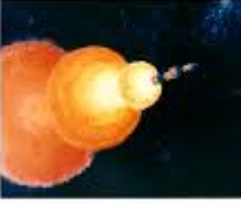
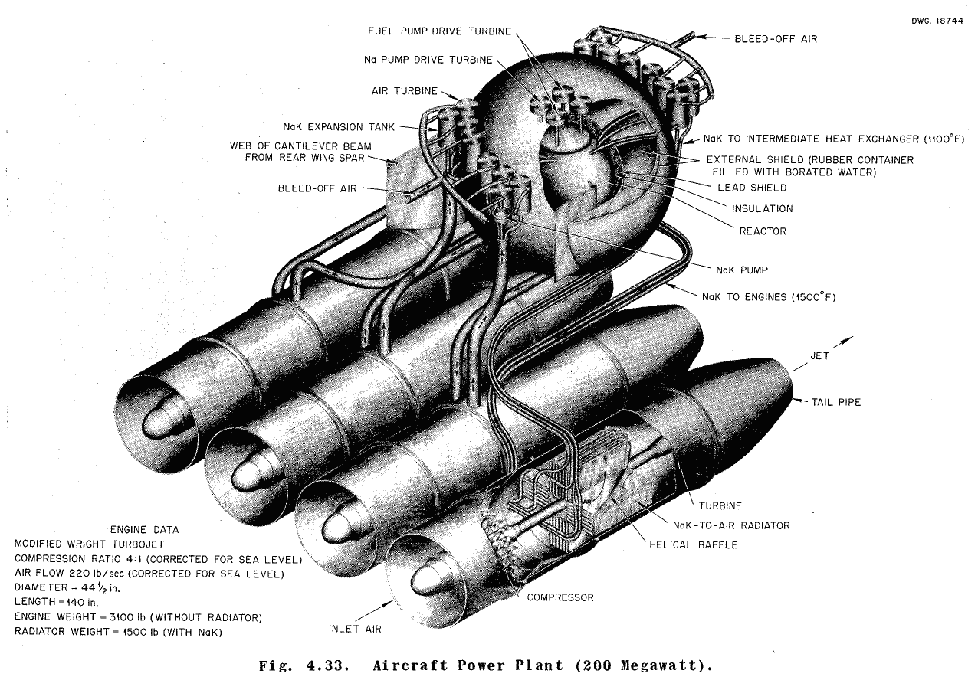
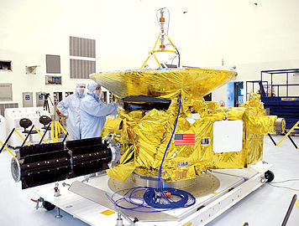
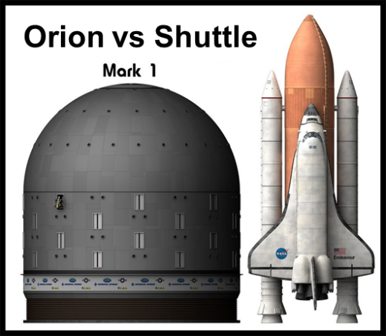
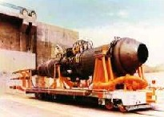
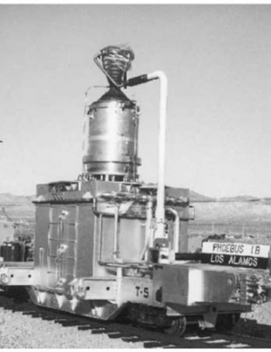
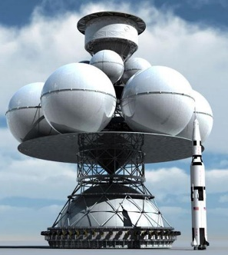
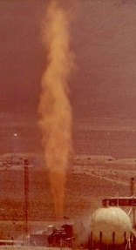
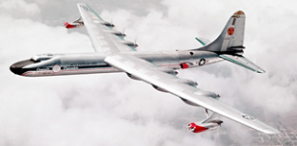
Is Nuclear Propulsion and Power Viable?
Viable: Feasible enough to be useful for practical applications:
Long endurance (days to months, longer than conventional systems)
High power density (kW to MW power for conventional tactical/strategic aircraft)
Intrinsically safe (no worse than jet fuel and if we scattered the system across the earth, we wouldn’t have to condemn the area for years)
A few examples which don’t meet these criteria:
6
Notes:
Tory II-C, Nuclear Ramjet: Several tests were conducted, culminating in a full-power test on May 20, 1964 where the reactor achieved a steady-state power output of 461 MW and an internal fuel temperature of 1690 K for approximately three minutes.

Slide 8
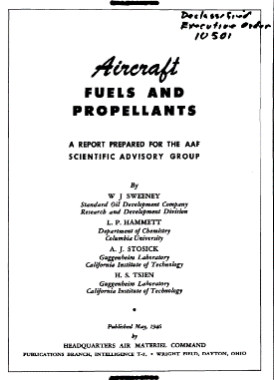

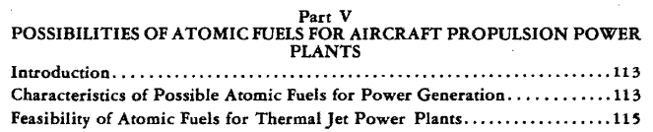
Russian Statement on Nuclear Propulsion
Underwater Drone
4 day endurance
100MT warhead
Faster than conventional torpedoes
"A nuclear-powered underwater drone is something the U.S. knew the Russians were working on... could carry a multi-megaton nuclear bomb with a range of about 10,000 kilometres moving at 56 knots, or 104 km/h and travel to a depth of more than 1,000 metres... capable of carrying a 100-megaton nuclear warhead, which Putin said could target coastal targets and warships.“
"one weapon did surprise some experts: the nuclear-powered cruise missile. 'The nuclear-powered cruise missile is the craziest part,' Geist said. 'Everybody's jaws dropped when that was mentioned because we had no idea they were working on it.' This missile can take an arbitrary path to its target and circumvent any enemy defenses. And the advantage to being nuclear-powered is that it can fly around for months..."
Cruise Missile
Months endurance/ loiter
Arbitrary path
Currently possible with fission and hazardous radio-isotope systems (both very effective dirty bombs) as described by the 1946 von Karman report to Hap Arnold
Can we do this with an intrinsically safe system?
Vol 7, Aircraft Fuels and Propellants
7

Slide 9
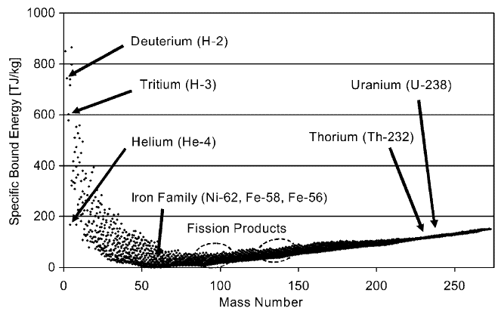
Nuclear Energy Summary
Must be Intrinsically Safe in order to relax current VP (or higher) level approval authority to fly.
Fission, Fusion, and Anti-matter not ready for approval any time soon.
Conventional Isotope Decay utilized for very long mission (years), low power density Thermal Electric Generators (RTG) with safety issues.
RTG Issues:
- Heavy
- Low Efficiency (5% typ)
- Must Reject Waste Heat
Are there isotopes and cycles that could be made intrinsically safe?
Isotope Decay
Process available Exergy
Fission U-235 75 TJ/kg
U-238 (via Pu-239) 77 TJ/kg
Seawater (3.3ppb U) 260 kJ/kg
Th-232 (via U-233) 78 TJ/kg
Fusion H-3 (via Li-6) 269 TJ/kg
H-3 (via Li-7) 162 TJ/kg
H-2 345 TJ/kg
Seawater (156 ppm H-2) 93 MJ/kg
Combustion Jet Fuel 40 MJ/kg
8

Slide 10
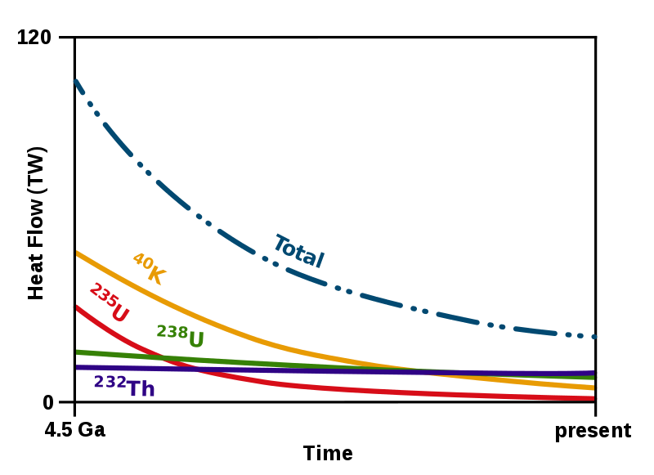
Earth’s Core Heating

Slide 11
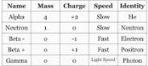
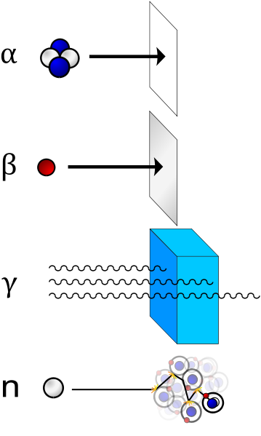

Atomic Transformation Processes
Shielding
Alpha (Helium)
(paper, skin, cell walls)
Beta – (electron)
(aluminum or metal sheet)
Beta + (positron)
(Lead or massive amounts of concrete, earth, …)
Gamma
(water, concrete)
Neutron
Notes:
In the human body, Potassium 40 (naturally occurring) 4400 decays per second produce 4000 natural positrons per day (511 keV gamma rays).
Potassium-40 is a rare example of an isotope that undergoes both types of beta decay. About 89.28% of the time, it decays to calcium-40 (⁴⁰Ca) with emission of a beta particle (β⁻, an electron) with a maximum energy of 1.33 MeV and an antineutrino. About 10.72% of the time it decays to argon-40 (⁴⁰Ar) by electron capture, with the emission of a 1.460 MeV gamma ray^{[1]} and a neutrino. The radioactive decay of this particular isotope explains the large abundance of argon (nearly 1%) in the earth's atmosphere, as well as its abundance compared to ³⁶Ar. Very rarely (0.001% of the time) it will decay to ⁴⁰Ar by emitting a positron (β⁺) and a neutrino.

Slide 12
RadioIsotopes (and some key parameters)
derived from Langham, NPS 2013
Want:
Short half-life (Decay quickly to harmless levels if dispersed?)
Low Radiation (Alpha/Low-energy Beta Decay doesn’t penetrate skin)
High Power per weight (kW/lb)
High Temperature Stability (high melting temperature/low CTE, or stable oxide)
More data? Other isotopes, secondary/tertiary decay, heat transfer considerations, cost,
Isotopes: 50,000-4,000,000 x 10⁶ J/kg
Jet Fuel: 40 x 10⁶ J/kg
Notes:
'safe' 2017 leak, only made in Eastern reactors, decays to Rh106 (Rhodium) then quick B- to stable Pd106 (Palladium)

Slide 13
Energy Storage
Energy Source Energy density
HC (+ 15 parts air) ~4.3 x 10E6 J/kg
Metals (Al, Boron, etc. + air) ~2-6 x 10E6
H₂ (+ 30 parts air) ~12 x 10E6
Methane (CH4) ~5 x 10E6
Explosives ~5 x 10E5
Fuel Cell ~1-5 x 10E5
Battery ~1-3 x 10E4
Spring ~1 x 10E2
Flywheel ~.2-3 x 10E5
Pressure (LN2) ~3 x 10E4
Pressure (3000psi air) ~.4-1 x 10E4
Hydraulic Accumulator ~1 x 10E4
RadioIsotope x 10E9 to 10E11
Fission (U235) ~8.2 x 10E12
25MW portable Fission x 10E1 per second (on semi trailer)
Fusion (D+T) ~5.6 x 10E13
Antimatter (p+e) ~9.0 x 10E15
5
Notes:
Portable Fission, 4x10e5 per hour, 2 days ~ 16 MJ/kg (HC at 30% eff), 259 MJ/kg per month, 3x10e9 per year, 3x10e10 per decade…

Slide 14
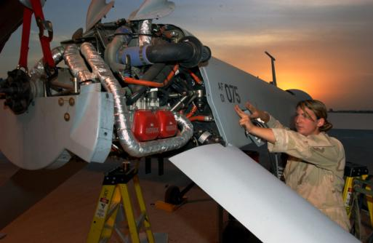
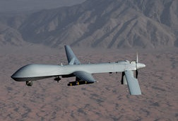
Radioisotope Decay Air Cycles
MQ-1B Case Study
Takeoff/Climbout 100kW
Cruise on 40kW
Internal Combustion Engine
200 lbs
~30% efficient
1080 hr rated life
50 hr maintenance cycles
360 hr overhaul cycle
250 hr MTBF
Fuel: 10 gph for 1 hr
4 gph for 24hrs
Total Fuel ~600 lb
Propulsion and Fuel
~800 lb for 24hrs
Takeoff/Climbout 100kW
Cruise on 40kW
Hybrid Jet Fuel/Isotope Turbine engine
50 lbs
~20% efficient (doesn’t matter much)
20,000 hr life
Fuel: 9 gph for 1 hr
Total Fuel ~100 lb (2x margin)
400kW Isotope Heat Exchanger at mission start, 200kW at half-life.
~30 lbs of Ru 106 (12 months)
64 lbs of Tm 170 (4 months)
Plus HEX Weight
Propulsion and Fuel
200-300 lbs for 3-12 months
(would probably make electric hybrid and double weight)
(Engines are to scale)
12

Slide 15
Radioisotope Decay Air Cycles
MQ-1B Case Study
Takeoff/Climbout 100kW
Cruise on 40kW
Internal Combustion Engine
In 4 months:
12,000 gallons of fuel
($180k at port plus convoy/tanker to point-of issue)
60+ takeoffs/landings
6 engine rebuilds
3 engines
12+ turbochargers
240 sparkplugs
10+ engine ‘failures’
Basing to sustain the above
Takeoff/Climbout 100kW
Cruise on 40kW
Hybrid Jet Fuel/Isotope Turbine engine
In 4 Months:
64 lbs of Tm 170
($192k in Tm 169)
1 takeoff/landing
Flexible Basing/Range
(Engines are to scale)
12

Slide 16
Beyond Case Study?
Short-Life RadioIsotope Hybrid Turbine Cycles could enable months of mission endurance for a wide variety of platforms
Huge impact upon enormous fuel logistics requirements
Greatly reduces #1 cause of Class A Mishaps (takeoffs/landings)

Slide 17
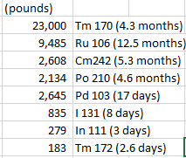
Mach 5+?
Consider Alternative Isotopes:

Slide 18
Potential Demo Systems?
‘Safe’
‘Dirty’
‘Catch up’
Similar to cruise missile thrust requirements (1000lb payload)
Thorium 228 with 1.91yr half-life decays to Stable Pb208 via Alpha/Beta(-) daughters at up to 8 MeV (not low energy), would require shielding (or remote operation) and liquid metal capable HEX

Slide 19
Summary/ Recommended Path Forward
Enables Hypersonics
Others actively investing in future propulsion/power capabilities beyond Hydrocarbon Fuels
Enables Conventional Propulsion and Directed Energy
Sustainable Ground Power
Nuclear power can enable unprecedented propulsion and power capability for a variety of applications (completely transforming current basing/logistic needs)
US is perhaps the least equipped to take advantage of nuclear power (breeder reactors, dismantled isotope capability, phasing out US fission, and bureaucracy/ policy/approval hurdles)
US has key expertise/partners and could enable Heated Air Cycle Engines with Intrinsically Safe approaches (better than jet fuel)
Requires vision and effort to enable

Slide 20
Next Steps
Heated Air Cycle Engine
Conduct Isotope selection and production scale up study. This would address supply and infrastructure issues.
Develop/validate isotope heat exchanger element performance.
Utilize surrogate, resistance heated heat-exchangers to develop HACE turbine engine. (E.G., inert Thulium 169 electrically heated). Enable ground power, APU, and subsonic propulsion applications.
Develop heat exchanger designs and propulsion systems for high-speed applications. Enable long range and much smaller hypersonic systems.

Slide 21
Backup

Slide 22
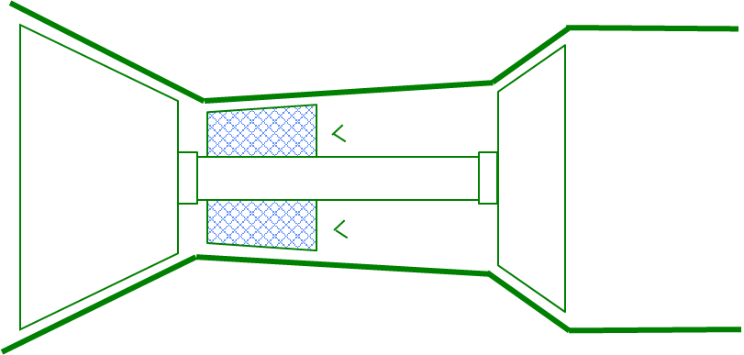
Controlling/‘Stopping’ the Engine when you can’t turn the heat off…
Safe Idle
Secondary Loop
Ground Support (air or water cooled)
Failsafe Heat Exchanger
(Radiant: Heat Loss ~ T⁴)
Pebble bed – Isotope could be coated and sized so if dispersed, pebbles are small enough to conductively/radiatively self-cool.
Remove or Disperse the Core (separate enough for free convection/radiation)
11

Slide 23
Other Mission Scenarios?
Heated Air Cycle Engine
Want a megawatt of electrical power? HACE can do that for an overall system weight of less than 1000 pounds (including fuel) for 4-12 months, eliminating the need for a million gallons of fuel per year.
Need to power an entire base in the middle of nowhere? HACE can make a portable power plant and keep you from having to fly in tankers daily to keep the system refueled.
Need a selectable orbit satellite?
Lightweight/long-range supersonic/hypersonic system with a shorter life heat source?
Avoid refueling OCONUS logistics for cargo/transport aircraft?
Extend the range of LCAAT from thousands of miles to millions of miles?
Launch U2's from a single site?
Have a UCAV/bomber/missileer loiter for months?
Replace a satcom network cheaply/quickly?
Follow/monitor potential threats indefinitely?
Eliminate the need for tanker fighter support?
…
Eliminate the safety issues associated with a fuel that has 10x the energy density of TNT? (that would be jet fuel)
Enable a propulsion/power cycle that can be adapted to future available heat energy (hybrid, remote-beamed-power, fission, fusion, positrons, ...)?

Slide 24
Other Applications
Long-term ISR
Naval Fleet Patrol
Sub Hunting
Sub Herding
Long Range Torpedo
Circling Missile Threat
FOB Power
Directed Energy Power
High-Altitude APU
Heavy Space Climb-out
Global Cruise Missile
Extreme Altitude ISR

Slide 25
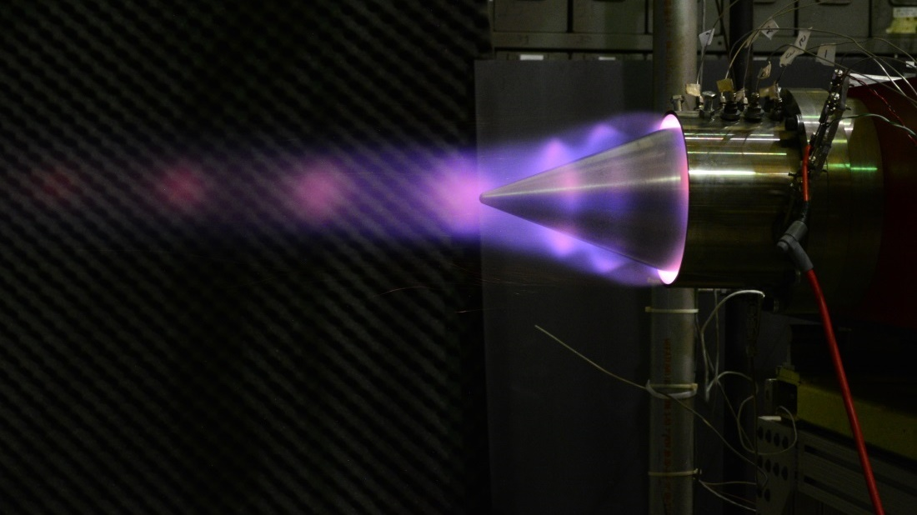

Slide 26
21 Feb Workshop Suggestions
Heated Air Cycle Engine
Utilize NETL Hyper research engine (external heat compatible)
Look at Concentrated solar engines and Nusource (portable nuclear power)
Identify DoE/DoD overlap, communicate interest in dual use tech
Consider CONOPS scenarios/return on investment:
Stealth persistent ISR
Ground Power
Satellite replacement (alterable orbit with orders of magnitude cost reduction)
Energy Resilience (10MW large base system requires ~1M gallons of conventional fuel a month)
Very Long range rapid response (even shorter half-life)
Extended range torpedo/Navy UAV
Prolific Energy enabling capabilities
Etc…

Slide 27
NENG 681 Project Results
Tm 170 Selected
Thulium Oxide form highly stable
50% production from Tm169 in 90 days with common US infrastructure
Isotope and Decay Chain Product (Yb in the form of Ytterbium Oxide) stable/compatible to 2200K
Tm169 costs comparable to logistics/costs for 4 months of fuel

Slide 28
Thulium Fuel Processing
Tm 170 Selected
Thulium Oxide form highly stable
Thulium can be alloyed with reactor-compatible metals such as Zirconia
Able to be pelletized to be charged in power station utilizing 0.001% of the pellet space
HEX made to incorporate standardized pellets
Simplified refueling possible
Notes:
Tm best now fueled in commercial power plants due to availability of slow/low-energy neutrons. Looking for isotopes with appropriate high energy neutron cross sections to be fueled on nuke carrier or sub. I think they exist…

Slide 29
Fuel Processing
Reactors needed to process isotopes
First Energy’s Davis-Besse plant near Toledo Ohio is asking for subsidies since it is no longer competitive with natural gas plants.
First energy threatening to close the plant.
National security argument to be made to help keep nuclear plants open with a secondary purpose.
Processing Tm may be cheap since they are strapped for cash.
Other nuclear plants in a similar situation.
Notes:
Tm best now fueled in commercial power plants due to availability of slow/low-energy neutrons. Looking for isotopes with appropriate high energy neutron cross sections to be fueled on nuke carrier or sub. I think they exist…

Slide 30
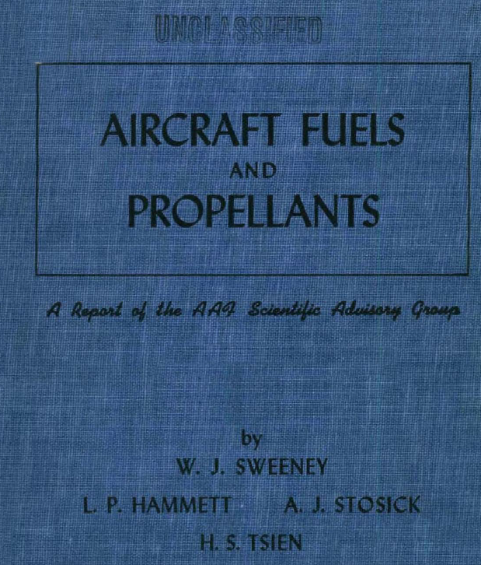
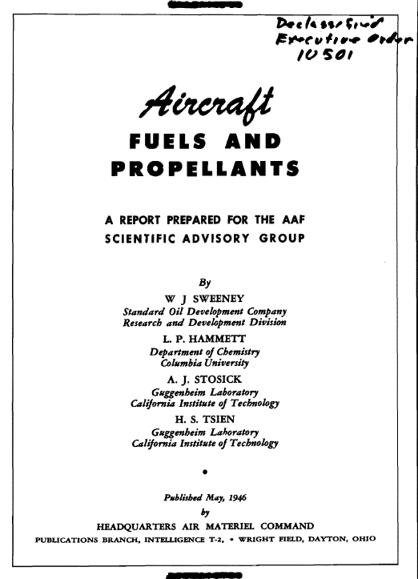


Slide 31
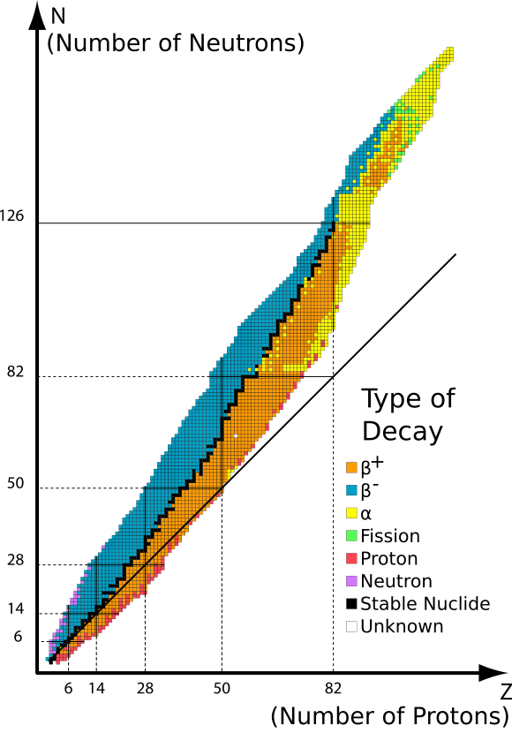
Isotopes

Slide 32
Atomic Transformation Processes
Shielding
Alpha (Helium)
(paper, skin, cell walls)
Beta – (electron)
(aluminum or metal sheet)
Beta + (positron)
(Lead or massive amounts of concrete, earth, …)
Gamma
(water, concrete)
Neutron
Notes:
In the human body, Potassium 40 (naturally occurring) 4400 decays per second produce 4000 natural positrons per day (511 keV gamma rays).
Potassium-40 is a rare example of an isotope that undergoes both types of beta decay. About 89.28% of the time, it decays to calcium-40 (⁴⁰Ca) with emission of a beta particle (β⁻, an electron) with a maximum energy of 1.33 MeV and an antineutrino. About 10.72% of the time it decays to argon-40 (⁴⁰Ar) by electron capture, with the emission of a 1.460 MeV gamma ray^{[1]} and a neutrino. The radioactive decay of this particular isotope explains the large abundance of argon (nearly 1%) in the earth's atmosphere, as well as its abundance compared to ³⁶Ar. Very rarely (0.001% of the time) it will decay to ⁴⁰Ar by emitting a positron (β⁺) and a neutrino.

Slide 33
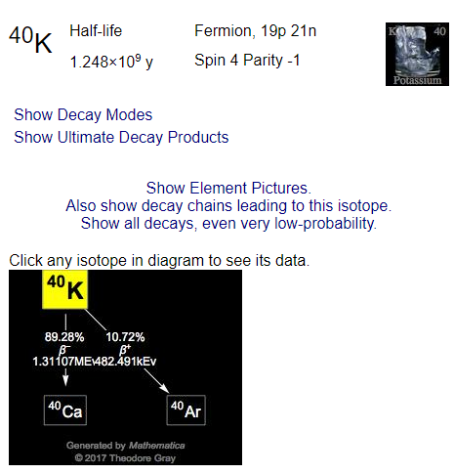
Potassium Decay
Banana Equivilant In the human body, Potassium 40 (naturally occurring) 4400 decays per second produce 4000 natural positrons per day (511 keV gamma rays).
~89% B-
~11% Electron Capture with 1.46 MeV gamma ray
0.001% B+ with positron (which annialtes to produce 511 keV gamma rays)
Notes:
Potassium-40 is a rare example of an isotope that undergoes both types of beta decay. About 89.28% of the time, it decays to calcium-40 (⁴⁰Ca) with emission of a beta particle (β⁻, an electron) with a maximum energy of 1.33 MeV and an antineutrino. About 10.72% of the time it decays to argon-40 (⁴⁰Ar) by electron capture, with the emission of a 1.460 MeV gamma ray^{[1]} and a neutrino. The radioactive decay of this particular isotope explains the large abundance of argon (nearly 1%) in the earth's atmosphere, as well as its abundance compared to ³⁶Ar. Very rarely (0.001% of the time) it will decay to ⁴⁰Ar by emitting a positron (β⁺) and a neutrino.

Slide 34
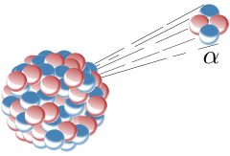
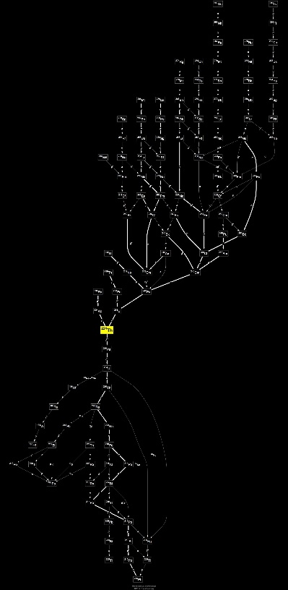
Alpha Decay
Example: Uranium 238 to Helium and Thulium 234 (which eventually decays to Lead 206)
Alpha particles have a typical kinetic energy of 5 MeV (or ≈ 0.13% of their total energy, 110 TJ/kg) and have a speed of about 15,000,000 m/s, or 5% of the speed of light. There is surprisingly small variation around this energy, due to the heavy dependence of the half-life of this process on the energy produced (see equations in the Geiger–Nuttall law). Because of their relatively large mass, +2 electric charge and relatively low velocity, alpha particles are very likely to interact with other atoms and lose their energy, and their forward motion can be stopped by a few centimeters of air. Approximately 99% of the helium produced on Earth is the result of the alpha decay of underground deposits of minerals containing uranium or thorium.

Slide 35
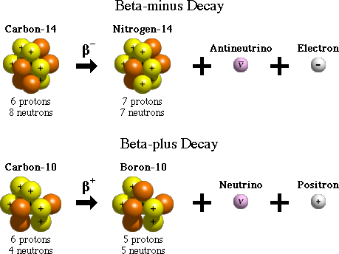
Beta Decay
B- Electron emission
Neutron loses electon, converts to Proton
B+ Positron emission
Proton loses positron, converts to Neutron
Positron will annilate as soon as it hits an electron, typically producing a gamma ray

Slide 36
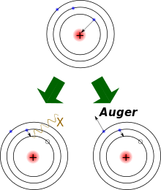
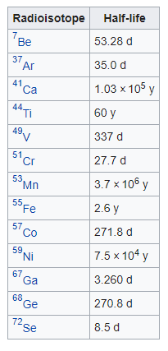
Electron Capture
Nucleus ‘captures’ an electron, converting a Proton into a Neutron.
Higher level electron then replaces missing electron (typically with emission)

Slide 37
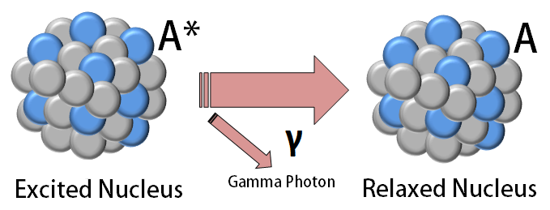
Gamma Decay
Excited nucleus achieves more relaxed state with high energy photon emission: Gamma rays are typically higher energy than x-rays, and penetrate and ionize.

Slide 38



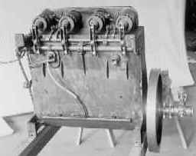
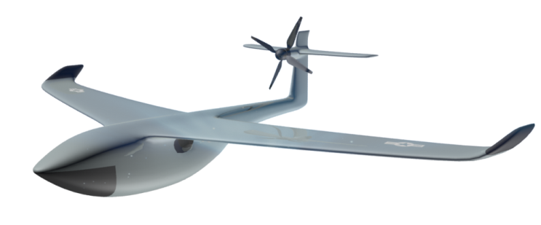
Air Force Prize Make more reliable, efficient engines using jet fuel
“Bending the cost curve” - SAF
Today, the Air Force seeks a highly efficient turbine engine to sustain the systems of tomorrow…
In 1903, the Wright Brothers developed a new, light-weight engine to power their glider…

Slide 39
State of the Art Propulsion Cycle Efficiencies Thermal Efficiency versus Pressure Ratio
Mil Turboshafts
Civ Turboshafts
OPR: Overall Pressure Ratio or Compression Ratio is a measure of technical complexity, cost, and weight
Notes:
OPR or Pressure Ratio is indicative of technical sophistication, complexity, structural weight, investment, etc…
Black line is ideal gas turbine with stated compressor/turbine efficiencies and T41 limit.
Higher pressure ratio is better to a point, then increased compression work starts to hurt.
Data points are Current and SOTA real engines.
SI (Otto cycle): Rotax (160hp) and Multipulse DI Research Engine (100hp, 300lb)
DI (Diesel): Thielert (125hp) and SOTA VW TDI (90hp)
Brayton:
Jetcat: 52 lb thrust, 5 lb)
AE2100/T406 (CV-22, C-130J): 6000hp, 971 lb
RR Trent 60 DLE: 70,000hp, 13100 lb
Compound (Atkinson like)
Wright R-3350: 3400hp, 2670lb
Napier Nomad: 3155hp, 3580lb
Surface Ship: 8. Wartsila-Sulzer RTA96-C * Engine Type: Two-cycle, 14-cylinder, inline * Displacement: 1,556,002 ci (25,480L) Yikes! * Bore and Stroke: 38x98 in (Roughly a 3 foot bore and 8 foot stroke!) * Aspiration: Turbocharged * Governed Speed: 102 rpm * Engine Weight: 2,300 tons (The city block-sized crank weights 300 tons) * Dimensions: 89 feet long and 44 feet high * Maximum Power: 108,920 hp at 102 rpm * Maximum Torque: 5,608,312 lb-ft at 102 rpm * Efficiency: 1,660 gallons per hour of heavy fuel oil

Slide 40
Energy Storage
Energy Source Energy density
HC (typ, + 15 parts air) ~4.3 x 10E7 J/kg
Metals (Al, Boron, etc. + air) ~2-6 x 10E7
H₂ (+ 30 parts air) ~12 x 10E7
Methane (CH4) ~5 x 10E7
Explosives ~5 x 10E6
Fuel Cell ~1-5 x 10E6
Battery ~1-3 x 10E5
Spring ~1 x 10E3
Flywheel ~.2-3 x 10E6
Pressure (LN2) ~3 x 10E5
Pressure (3000psi air) ~.4-1 x 10E5
Hydraulic Accumulator ~1 x 10E5
RadioIsotope x 10E10 to 10E12
Fission (U235) ~8.2 x 10E13
25MW portable Fission x 10E2 per second (on semi trailer)
Fusion (D+T) ~5.6 x 10E14
Antimatter (p+e) ~9.0 x 10E16
Notes:
Portable Fission, 4x10e5 per hour, 2 days ~ 16 MJ/kg (HC at 30% eff), 259 MJ/kg per month, 3x10e9 per year, 3x10e10 per decade…

Slide 41
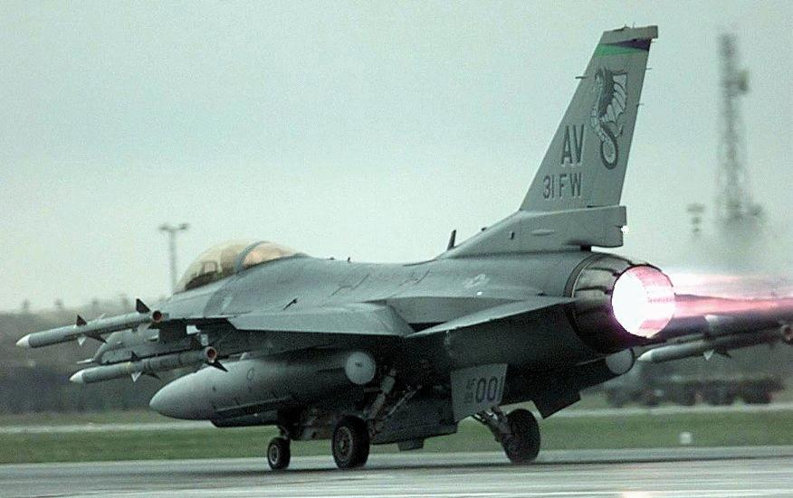
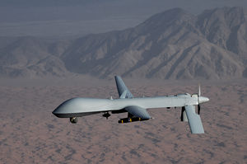
Sustainable Air Power
Formerly the Cheapest Combat Air Patrol
Cheaper Combat Air Patrol
F-16
Fuel: 600gph (20MW) at best cruise
Endurance: hours
Ops Tempo: 20-60 hrs/month
Strike Capability: lots
Combined ACC flight hours
(F-15, F-16, F-22, F-35, U-2):
96,000 hrs Annually
126,500,000 gallons
(1300 gphr avg)
MQ-1b
Fuel: 4gph (130kW) at best cruise
Endurance: 24 hours
Ops Tempo: 300 hrs/month
Strike Capability: 2
360,000 hrs
1,500,000 gallons
(4 gphr)
Notes:
Numbers cited are from peak of Iraq/Afghanistan Gulf War

Slide 42
MQ-1b Case Study
Takeoff/Climbout 100kW
Cruise on 40kW
Internal Combustion Engine:
200 lbs
~30% efficient
1080 hr rated life (4 engines/year!)
50 hr maintenance cycles
360 hr overhaul cycle (1/month!!)
250 hr MTBF (> 1/month!!!)
Fuel: 10 gph takeoff/climbout for 1 hr
4gph cruise for 24hrs
Total Fuel ~600 lb
Propulsion and Fuel
~800 lb

Slide 43
Predator Airframe Hits 20,000 hrs
80,000 gallons of fuel
$1.3M in gas at shipping terminal
plus delivery to point-of-issue
Over 500 takeoffs/landings
Over 30 engines
60 engine overhauls
($5M+)
Probably 100 turbochargers
($1.5M+)
Probably 50 ‘engine failures’
Notes:
Numbers cited are from peak of Iraq/Afghanistan Gulf War

Slide 44
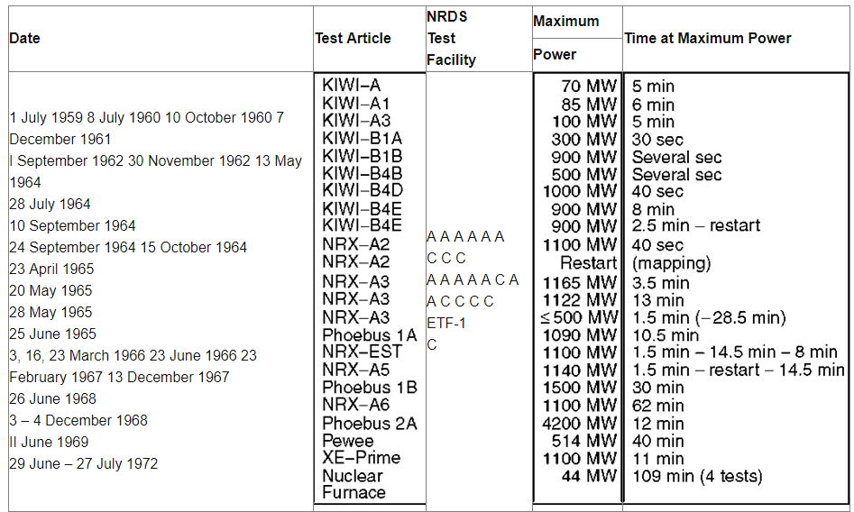

Slide 45
Conventional Turbine
Jet Fuel (~42 MJ/kg)
Fuel Injector
Combustor
(converts chemical energy to heat)
Nozzle (thrust) or
Power Turbine (power generation)
Air
(cycle working fluid)
Shaft (transmits power)
Bearing
Case
Compressor
(squeezes air)
Turbine (power extraction to drive compressor)
Modest Efficiency (10-40% depending upon scale/throttle)
Cycle Waste Heat leaves as exhaust (thrust)
Inherently Reliable (no sliding seals)

Slide 46
Turbine Cycle Energy Input
Throttleable
Waste Heat leaves as exhaust
Fly for hours/days
Conventional Turbine
Combustor
Heated Air Cycle
Turbine (HACT)
Throttleable
Waste Heat leaves as exhaust
Refuel for 4-13 months
Minimize takeoff/landings/fuel logistics
Select:
low energy decay isotope to mitigate shielding requiriments
‘Short’ half-life that are benign in years
Significantly higher efficiency and power density than conventional RTG/TEG
Design for intrinsic safety
RadioIsotope Heat Exchanger
(sized for cruise power)
Combustor
(only used for takeoff/climb/dash)

Slide 47
Radioactive Nuclide Production for Radioisotope Propulsion
Air Force Institute of Technology
14 December, 2017
Notes:
Capt Leslie

Slide 48
Overview
NENG 681 Looked at Po 210 and Tm 170
Po 210 from Bi 210:
low production potential
Low melting temperature
Product is Lead (low melting temperature)
Tm 170 from Tm 169
High production potential
Product is Yb 170 (stable)
Notes:
Capt Leslie
diffusivity

Slide 49
Bi-209 Irradiation
Isotope | Po-210 | Bi-209 | Bi-210 | Tl-206 | Bi-210m | Pb-206
Grams | 2.01E-05 | 0.999 | 1.06E-06 | 1.44E-08 | 1.65E-05 | 1.39E-05
Ci | 9.02E-02 | ~0 | 1.31E-01 | 9.68E-04 | ~0 | 2.01E-05
Watts | 3.02E-04 | ~0 | 0.000302 | 3.10E-06 | ~0 | 0
Low production of Po-210 in volume.
Result expected from low absorption cross section of Bi-209.
Nearly all Bi-209 remains after 8 months of irradiation.
Low contribution isotopes not included (~0)
Total 0.0032 W/g-feed
Notes:
Nick

Slide 50
Full Irradiation Simulations
Electrical Power Requirements 40 kW
Assume 30% thermal power efficiency to turbine power
Iteratively determined requires 164.4 kg of thulium oxide
Radioactive decay requires that the electrical power produced is at End of Life (EOL)
After EOL, radioisotopes need to be replaced.
EOL goal of 6 months
Irradiation [90 Days]
Processing and Assembly [2 Months]
Operations [6 Months]
Notes:
Nick

Slide 51
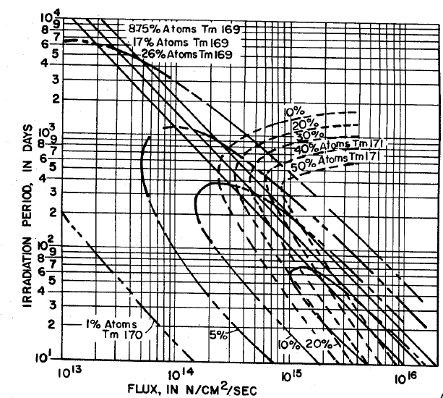
Full Irradiation Simulations
Irradiation Thulium-Oxide for 90 days.
Flux availability:
Commercial Reactor (Irradiation timescale not great pairing for scheduling with core refuel.
High Flux Isotope Reactor ~ 10^15 n/cm^2-s flux
US Patent No 3,432,386
Notes:
Nick

Slide 52
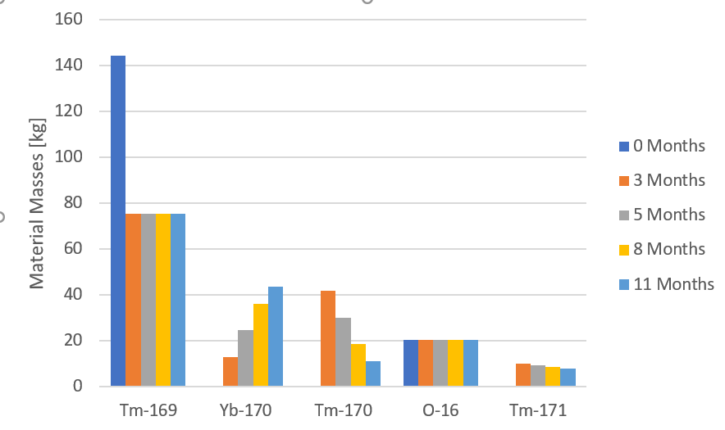
Tm-169 Irradiation Mass Production
Starting Mass is 164.4 kg of Thulium Oxide
Large Production of Tm-170, decays to Yb-170
Notes:
Nick

Slide 53
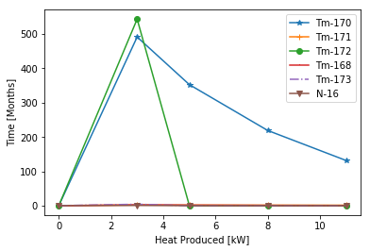
Tm-169 Irradiation Heat Production
Large heat from Tm-172 decays quickly.
Places restriction on delay time from post-irradiation to operation
Tm-170 has longer half-life, primary source for heat generation.
Notes:
Nick

Slide 54
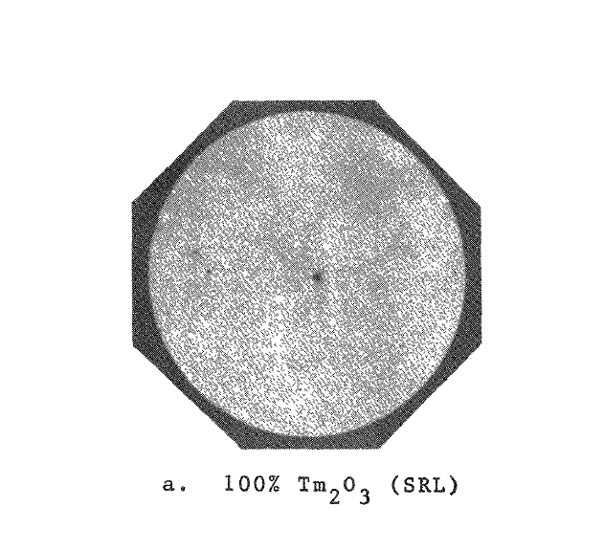
Material Properties
Banders Nuclear Corporation
Notes:
Bryan

Slide 55
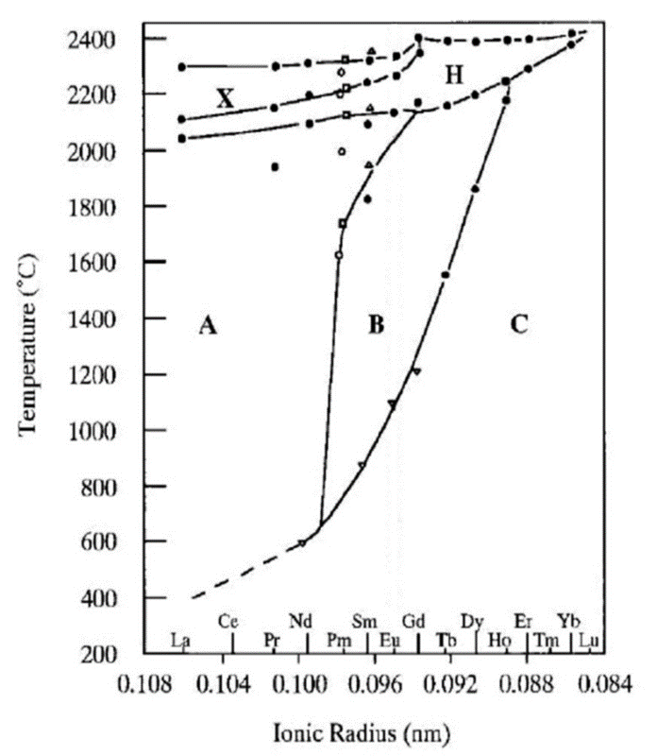
Thermal Properties
No phase changes for the desired temperature ranges, up to 2300 degrees Celsius
From 100/0 Tm/Yb composition to 0/100, the melting temperature was higher than 2300 degrees Celsius
Notes:
Bryan

Slide 56
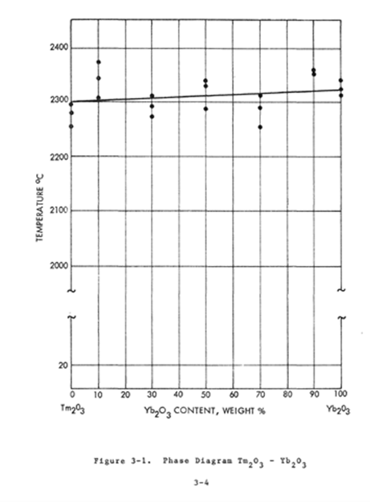
Thermal Properties
Notes:
Bryan

Slide 57
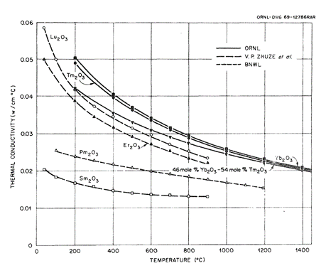
Thermal Conductivity
$K=0.0782e^{9∗{10}^{−4}∗T}$ [W/m-K]
Notes:
Nick

Slide 58
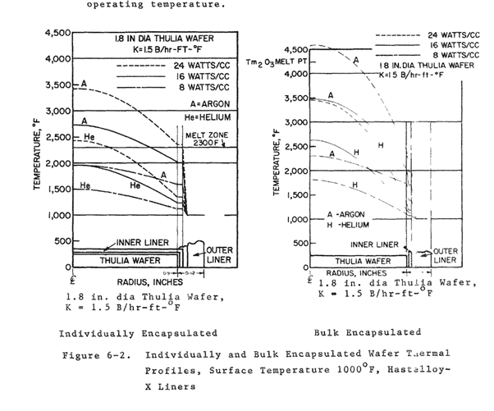
Heat Profile
Notes:
Bryan

Slide 59
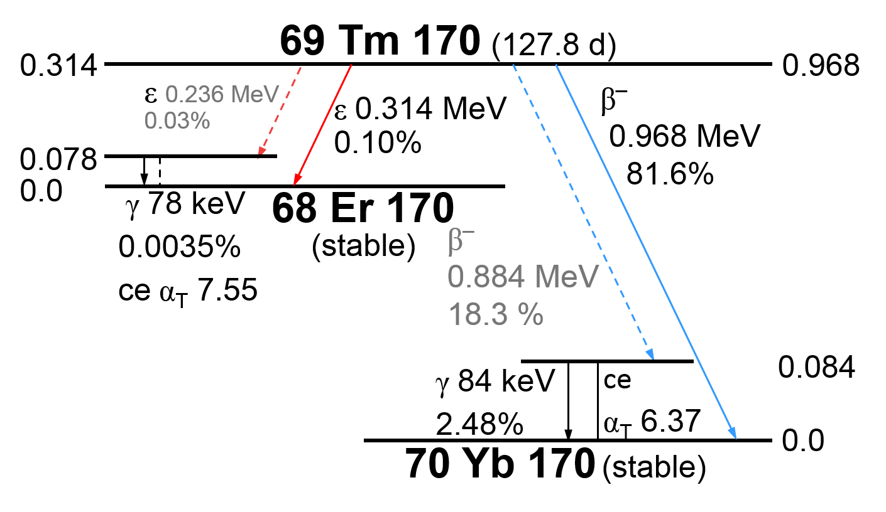
Radiation Properties
Two low energy photons, and Bremsstrahlung effects from two Beta emissions
Notes:
Bryan

Slide 60
Environmental Barrier Coatings (EBC)
Used within aircraft turbine engines to coat the outside of oxidation sensitive components particularly ceramic components which are highly sensitive to oxidation and volatilization
Material requirements:
High phase stability
Similar thermal expansion coefficients to the materials they are covering
Corrosion-resistant
Notes:
Amy

Slide 61
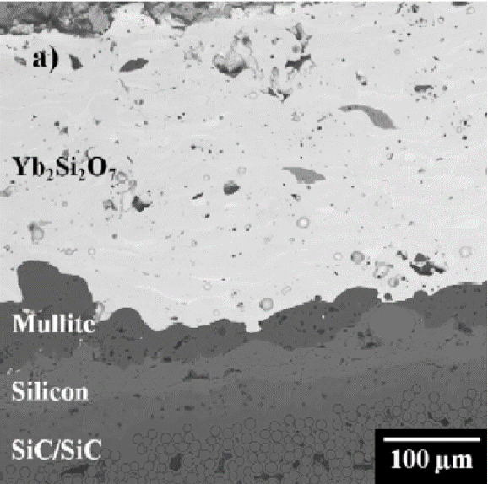
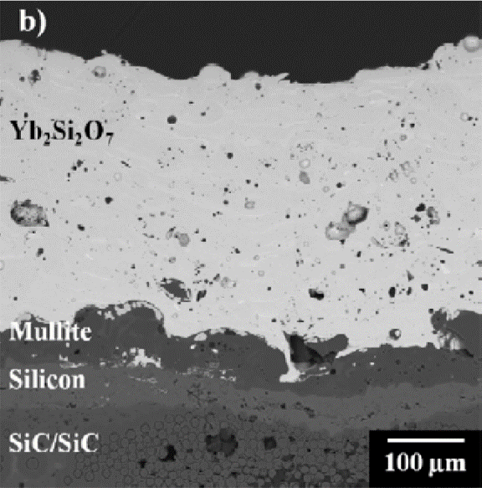
Ytterbium Disilicate EBC
Ytterbium disilicate (Yb₂Si₂O₇) satisfies the characteristics necessary to be used as an EBC
It can be subjected to up to 1800 K
High phase stability
Stress tested for 10,000h with 3% of coating showing signs of degradation
Yb₂Si₂O₇ is a promising option for an EBC to coat the ceramic oxide fuel
Yb₂Si₂O₇ as applied
Heated at 1300°C for 100h
Notes:
Amy

Slide 62
Material Evaluation
Melting Temperatures:
Tm₂O₃: 2301 ± 33.5°C
Yb₂O₃: 2328 ± 33.5°C
Both remain solid and cubic crystal structure
Yb₂Si₂O₇ coating
Radiation properties:
Self-shielding
3 inches of lead maximum
Notes:
Amy

Slide 63
Isotope Selection Questions
Isotope:
Production
Handling
Decay Chain
Disposal
Accident/dispersal
Mission/Cycle:
Turbine Cycle
Isotope Heat Exchanger Requirements
Heat Exchanger Integration:
kg per kW
Temperature Stability (1800-3000 ºF with reasonable CTE)
Packaging (plate-fin/porous/balls/coatings?)
Heat Exchanger Design

Slide 64




AFRL/RQTC Advanced Concepts Group
Notes:
6 watt MHD
100 watt combustion
to 650MW

Slide 65


Global Exergy Flow & Sources
Solar
17GW from
135,000 TW
Fuels
12 TW
from 630 ZJ
(~1000 years)
Aviation
350 GW
3% of Fuels
1.6% of Human
Geothermal
20 GW from
15,000,000 ZJ
320,000 TW (crust transfer)
80 TW Volcanic
Human
~25 TW
50% Fuels
38% Ag/Forestry
Fission
300 GW
from 1300 ZJ Ore 360,000 ZJ seawater
Fusion
3100 ZJ Ore
30,000,000,000 ZJ seawater
Global Climate and Energy Project at Stanford (http://gcep.stanford.edu/)
Ver 1.0 April, 2009 © MRS Source: Proceedings of the 2009 MRS Spring Meeting
Notes:
360 Million km2 x 1000kg/m3 = 360 x10e15 kg of water
Net Solar is 135,000 TW

Slide 66


Cycle Efficiency with Throttling
T63 Turboshaft
Efficiency
Shaft Power Output (kW)

Slide 67
Fuels…

Slide 68







Advanced Propulsion Concepts
Alternative Energy Sources

